Slide 1
Relationship between homicide deaths and opioid drug overdoses in the US between 1999-2014
Attila Szuts, Tymur Antonovskyi, Ansar Kokbayev

Slide 2




Slide 3
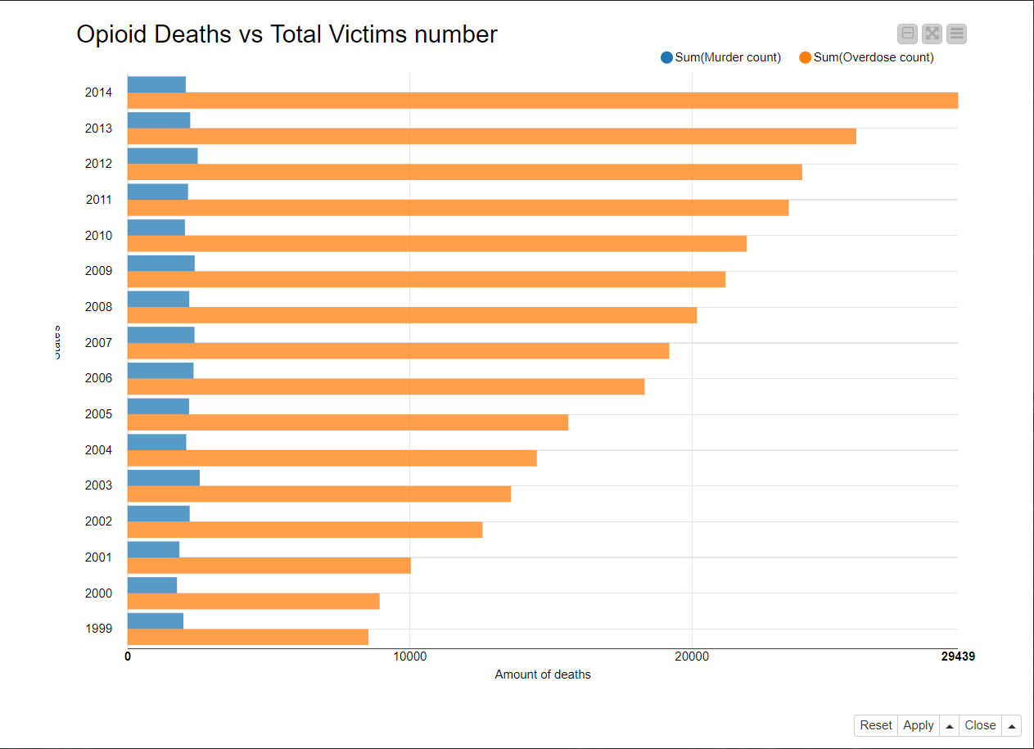

Slide 4
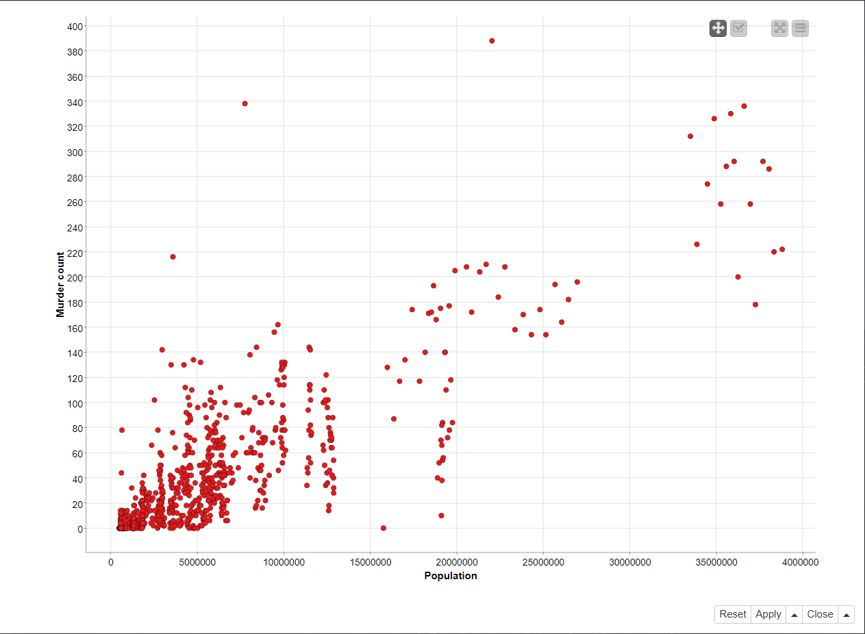

Slide 5
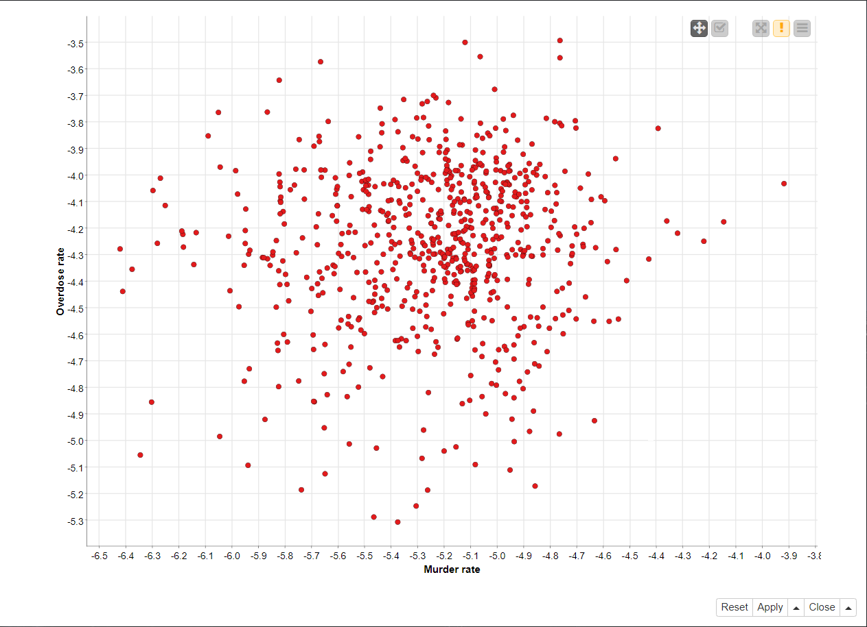

Slide 6
